Slide 1
EV Battery Management System
Mega Project | July 2026

Slide 2
EV Battery Management System
Agenda
AGENDA
Project Overview Dataset Tech Stack & Python Concepts Used Output / Dashboard Summary Future Scope

Slide 3
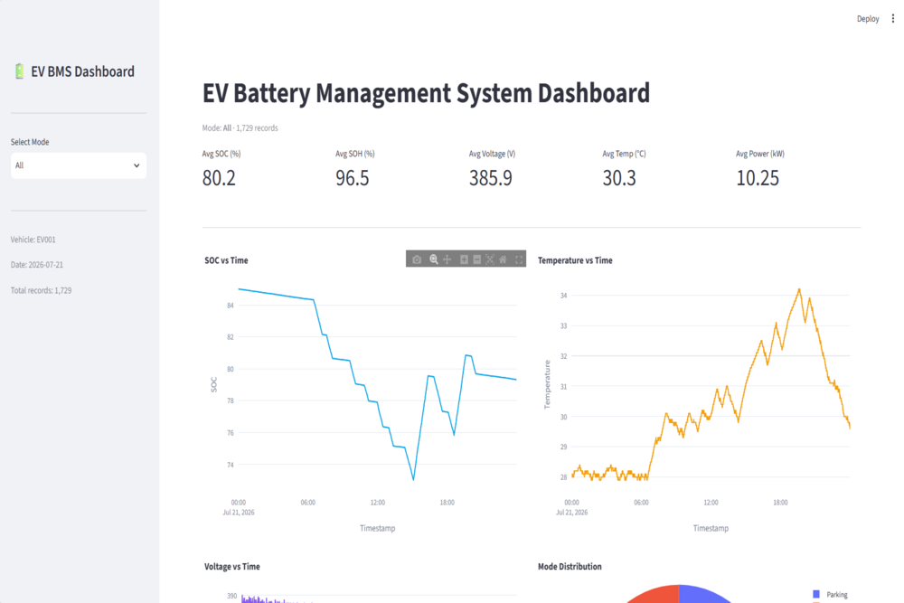
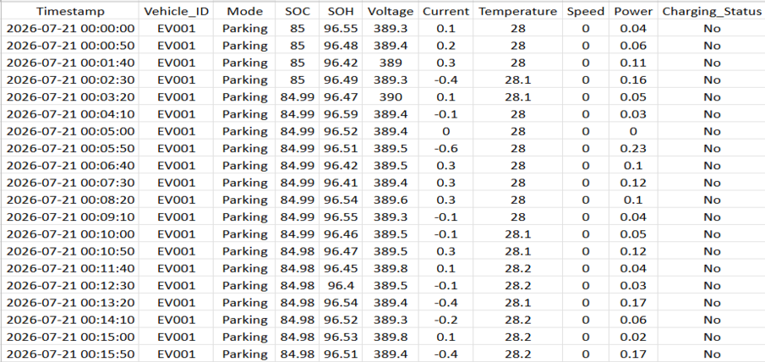
1. Project Overview
1.1 What is EV Battery Management System ?
A Battery Management System (BMS) monitors and manages the rechargeable battery pack in an Electric Vehicle, ensuring safe and efficient operation
Tracks critical parameters like State of Charge (SOC), State of Health (SOH), voltage, current, temperature, speed, and power in real time
Built for real-world use cases such as EV fleet monitoring, battery health analytics, charging optimization, and predictive maintenance
EV Battery Pack
1.2 System Architecture & Data Flow
Dataset Generator creates realistic battery telemetry data for vehicle EV001 across a full day (1,729 records at 50-second intervals)
Firebase Firestore stores each telemetry record in real time as the trip progresses
Streamlit Dashboard loads the dataset and renders KPI cards, interactive Plotly charts, and mode-specific analytics
Analytics modules (Trip, Speed, Fuel, Engine, Driving Behavior) process the data to generate insights and trigger alerts.
BMS Data Analysis Pipeline
EV Battery Management System Dashboard | Group Project Presentation
3

Slide 4
2. Dataset
2.1 Dataset Description
Realistic dataset generated by a custom Python script (generate_dataset.py) — saved as Excel (.xlsx) file
Each record captures: Timestamp, Vehicle_ID, Mode, SOC, SOH, Voltage, Current, Temperature, Speed, Power, Charging_Status
Dataset covers one full day (21 July 2026) with 1,729 rows at 50-second intervals for vehicle EV001
Three operating modes simulated: Driving (SOC decreases, speed > 0), Charging (SOC increases, current negative), Parking (SOC stable, speed = 0)
Data is streamed to Firebase Fire store under vehicles/{vehicle_id}/telemetry, refreshing every 10 seconds
Data Set :-sample_bms_data.xlsx
Git Link :-https://shorturl.at/RGij9
EV Battery Management System Dashboard | Group Project Presentation
4

Slide 5
3. Tech Stack & Python Concepts Used
Technology | Purpose
Python | Core language for data generation, analysis, and dashboard
Streamlit | Builds the interactive web dashboard with sidebar and KPI cards
OpenPyXL | Reads and writes Excel .xlsx files from Python
Pandas | Data loading, filtering, aggregation (mean, min, max)
Plotly Express | Creates interactive line charts, pie charts with dark theme
NumPy | Random data generation and mathematical operations
ReportLab | Embeds the NumPy map inside the dashboard
Object-Oriented Programming — dedicated classes for the Telemetry Generator, OpenPyXL Service/Reader, and every Analysis/Dashboard module
Modular Package Design — code organized into simulator, firebase, analytics, dashboard, and services packages
Streamlit Caching — @st.cache_data decorator caches Excel file reads for instant dashboard reruns
Random Module — random.uniform() and random.randint() generate realistic telemetry values
Math Module — Haversine formula (radians, sin, cos, atan2) calculates GPS distance between coordinates
Pandas Operations — Data Frame sorting, iloc, mean/max/min aggregation, and column renaming
REST API Integration — the library fetches live road routes from OSRM
EV Battery Management System Dashboard | Group Project Presentation
5

Slide 6

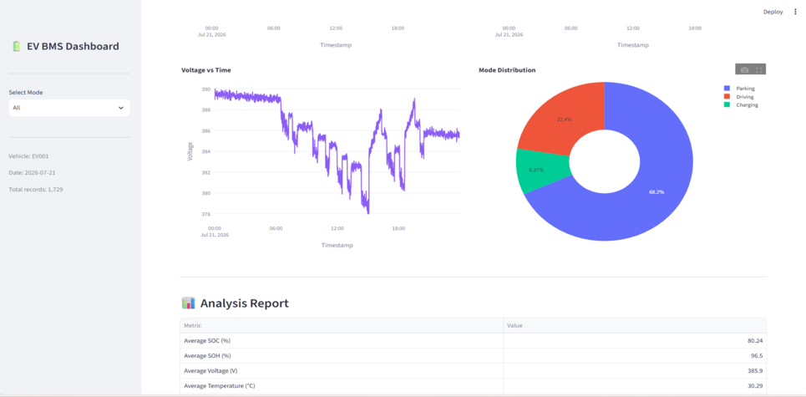
4. Output Report
4.1 Dashboard Overview
Vehicle Information panel — Vehicle ID, Manufacturer, Model, Registration Number, Driver Name
Live KPI cards — Current Speed, Fuel Level, Engine Temperature, Distance Travelled
Trip Summary — Average & Maximum Speed, Fuel Consumed, Trip Duration
Driving Behavior Summary — Normal / Harsh Acceleration / Harsh Braking / Overspeed counts with a donut chart
Vehicle Alerts — Overspeed and high engine temperature warnings
Emergency SOS button — simulated emergency alert trigger
EV Battery Management System Dashboard | Group Project Presentation
6

Slide 7
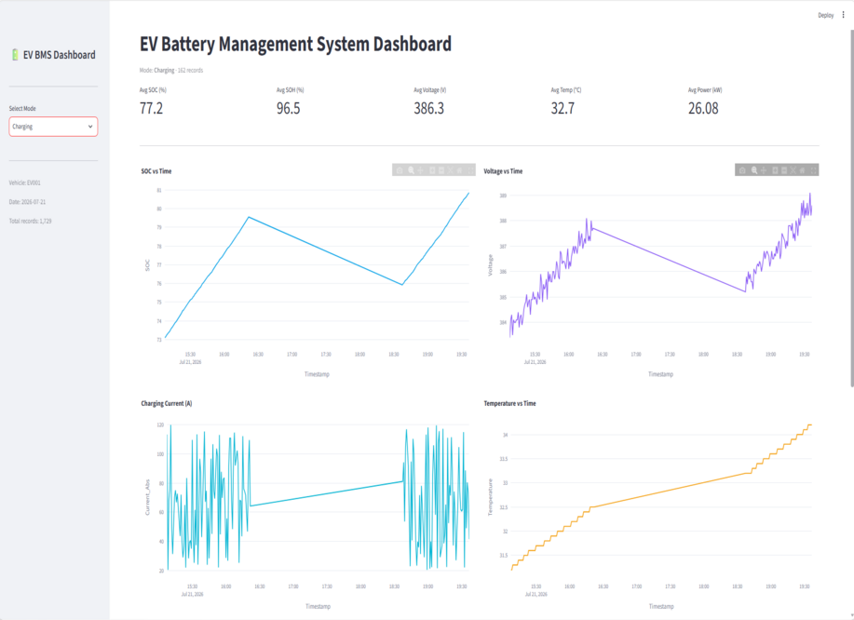
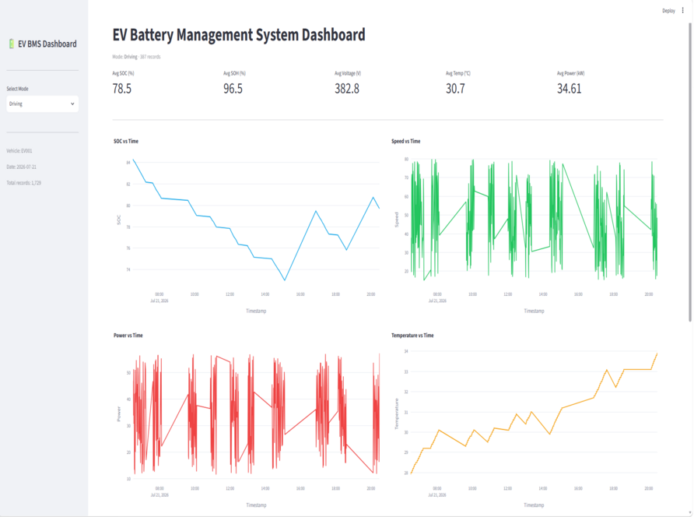
4. Output Report / Dashboard
4.2 Driving & Charging Mode Views
Driving mode shows SOC depletion, vehicle speed patterns, power consumption, and temperature rise during trips
Charging mode shows SOC recovery, voltage increase, charging current flow, and thermal behaviour during sessions
EV Battery Management System Dashboard | Group Project Presentation
7

Slide 8
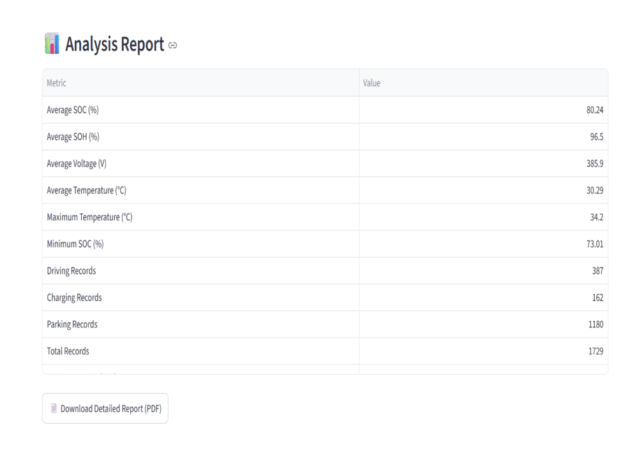
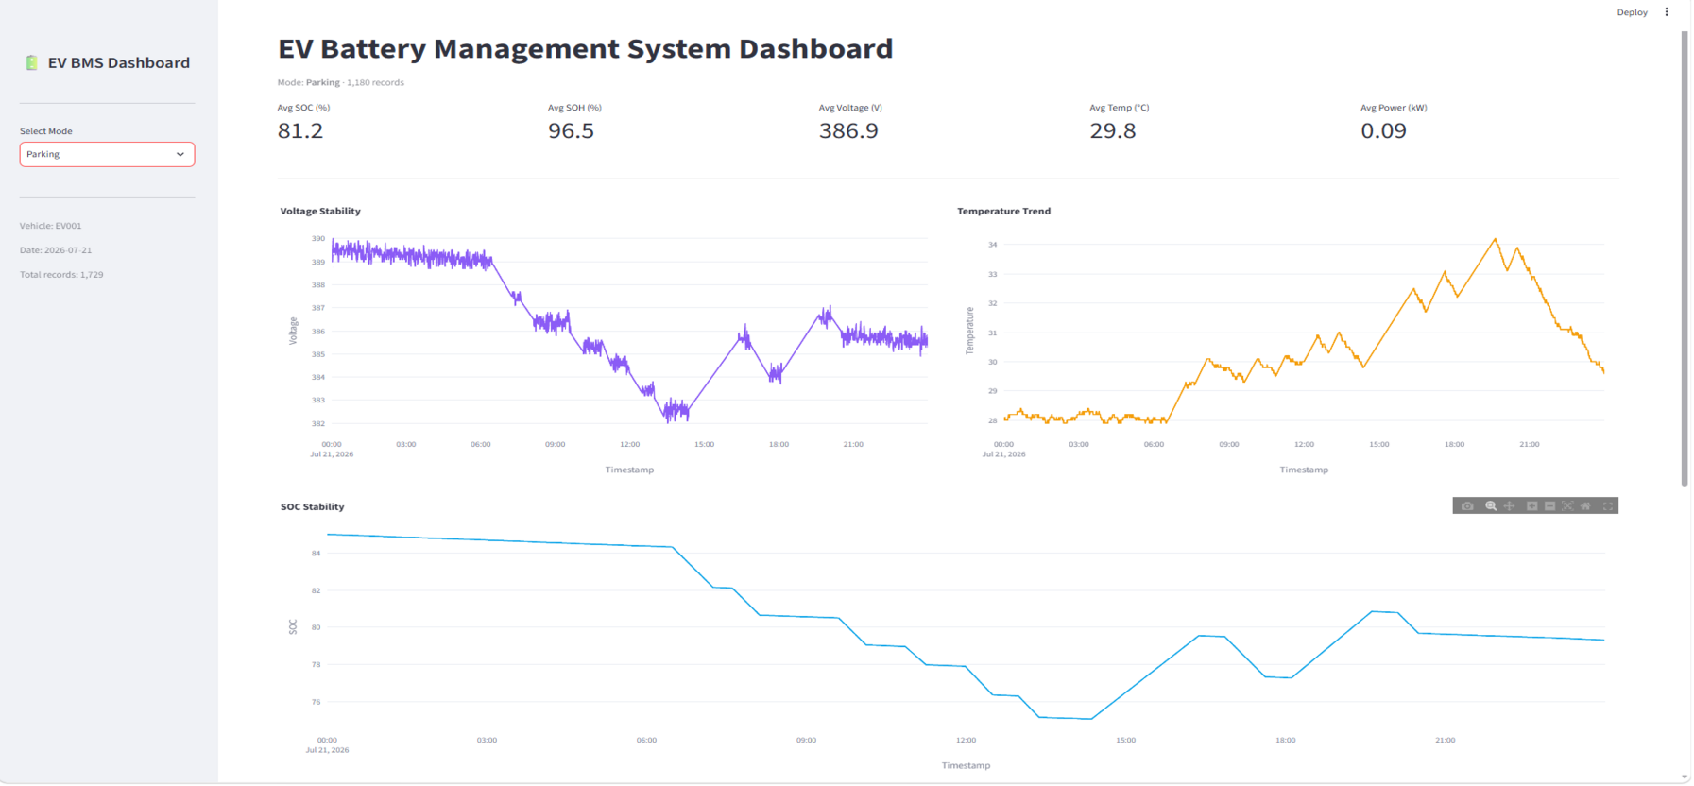
4. Output Report / Dashboard
4.3 Parking Mode & PDF Report
Telemetry data table, driving-behaviour tags, vehicle alerts, and the Emergency SOS panel
EV Battery Management System Dashboard | Group Project Presentation
8

Slide 9
5. Summary & Future scope
5.1 Project Summary
Built a complete EV BMS analytics platform — Dataset Generation → Excel Storage → Dashboard Analytics → PDF Reporting
Demonstrates practical integration of data analysis, interactive visualization, and automated report generation using Python
Provides actionable insights into battery health, charging patterns, SOC trends, and thermal behaviour across operating modes
Applicable to EV fleet management, battery warranty analytics, charging infrastructure planning, and predictive maintenance
5.2 FUTURE SCOPE
Integrate real OBD-II / CAN bus data for live battery monitoring
Add ML-based SOH prediction and battery degradation forecasting
Build a multi-vehicle fleet dashboard for organization-wide EV monitoring
Enable cell-level balancing and individual cell thermal analysis
Deploy to Streamlit Cloud / AWS for remote access and team collaboration
Develop anomaly detection for fault prediction and automated safety alerts
EV Battery Management System Dashboard | Group Project Presentation
9

Slide 10
THANK YOU

